Slide 1
Protection against invaders
Bacteria and Virus

Slide 2
Pathogens
a bacterium, virus, or other microorganism that can cause disease.
Pathogens must first enter the body and evade the non-specific defences such as skin, mucous, and patrolling phagocytes and granulocytes.

Slide 3
Bacteria vs Virus
Both bacteria and viruses can be considered to be pathogens as they have the ability to cause disease. There are some non-pathogenic bacteria in our bodies (”good” bacteria e.g. in the gut)
There are some similarities between the two pathogens and many differences.

Slide 4
Bacteria vs Virus
Your task is to in pairs produce an A3 or larger poster detailing the differences and similarities. (20 minutes)
Your poster should include at least:
A definition of both bacteria and virus
Information regarding differences and similarities eg size, cell wall, cytoplasm, genetic material etc. (should be able to get at least 7-8 minimum)
10 examples of each
How you choose to present that information on your poster is up to you eg. paragraph, dot points, table etc.

Slide 5
Transmission of Pathogens
Bacteria and viruses are classed as communicable or infectious diseases, meaning they can be passed from one person to another.
These pathogenic organisms can be passed in a number ways:
Transmission by contact
Transfer of body fluids
Infection by droplets
Ingestion
Airborne transmission
Transmission by vectors

Slide 6
1. Transmission by contact
Spread of pathogenic organisms through physical contact. Contact may be direct or indirect.
Direct: Physically touching an infected person
Indirect: Touching an object that has been touched by an infected person.
Examples include skin infections such as some STI’s and athletes foot (tinea)
2. Transmission of body fluids
Blood or other bodily fluids from an infected person comes into contact with the mucous membrane (particularly in nose, mouth, throat and genitals) or bloodstream of uninfected person.
Examples include HIV, Hepatitis B and C.

Slide 7
3. Infection by droplets
Tiny droplets of moisture containing pathogenic organisms are breathed in or ingested.
These moisture droplets can be emitted through coughing, sneezing, breathing or talking.
Examples include viral infections such as measles, mumps, colds and influenza.
4. Ingestion
Eating or drinking food which has been contaminated with pathogens.
Examples include Dysentery typhoid fever and salmonella

Slide 8
5. Airborne transmission
Similar to infections by droplets. Most often bacteria will die once exhaled, however virus and some bacteria may survive and when inhaled can cause infection.
6. Transmission by vectors
A vector is an agent such as an insect which is capable of transferring a pathogen from one person to another.
Vectors may transfer a pathogen either directly or indirectly (pathogen being spread to food and water and then ingested).
Vectors are quite often specific to a disease eg. malaria and dengue fever transferred by mosquitos

Slide 9
Summary
book and notes from the previous slides, draw up a table summarising how pathogens can be transferred. You should include information such as:
Where does the pathogen originate from
How is the pathogen taken up by a person eg. touch, inhalation
Examples of pathogens transferred in the way

Slide 10
Defenses against disease
Most pathogenic organisms are never able to enter the body, and if they do they are destroyed before they cause symptoms of disease.
Our bodies defense system against pathogens can be broken down into two categories, non-specific defense and specific defense.
This chapter will focus on NON-SPECIFIC defense.

Slide 11
Non Specific Defenses
Non-specific defenses are our bodies first line of defense. They are, as the name suggests, non-specific meaning they work against all pathogens.
Non-specific defenses can be either external or internal defenses. These include:
External
Skin
Mucous membranes
Hairs
Cilia
Acids
Lysozyme
Cerumen
Flushing action
Internal
Phagocytes
Leucocytes
Macrophages
Inflammation
Fever

Slide 12
External non-specific defenses
Skin
Acts a physical barrier between the internal and external environment of the body. It is difficult for pathogens to become established on the skin as it is continually occupied by other bacteria.
Secretes sebum, an oily fluid that can kill pathogens.
Fatty acids and salts in sweat also prevents micro-organisms from growing.
Mucous membranes
Line body cavities and secrete mucous which prevents entry of pathogens into the body.

Slide 13
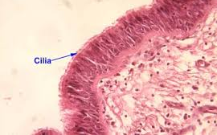
External non-specific defenses cont.
Hairs
Used to trap particles and prevent them moving through respiratory system.
Cilia
Tiny hairs which move with a beating motion. Their role is to move mucous contain trapped micro-organisms to the throat.

Slide 14
External non-specific defenses cont.
Acids
Acidic fluids which can destroy micro-organisms. Example include stomach juices, acidic secretions from the vagina and also sweat.
Lysozyme
Bacteria killing enzyme. Found in tear, sweat, saliva and secretions of nose and tissue fluid.
Cerumen (ear wax)
Slightly acidic and contains Lysozyme, protecting the outer ear.

Slide 15
External non-specific defenses cont.
Flushing action
Movement of fluids prevent pathogens from infecting the body. Examples include tears, sweat, saliva and the movement of urine through the urethra to be expelled. Can prevent bladder or kidney infections are bacteria cannot move up urethra.

Slide 16
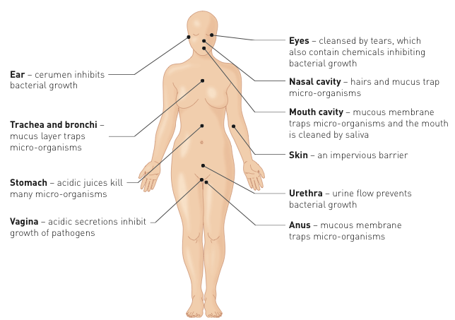
External non-specific defenses Summary

Slide 17
Protective reflexes
Automatic response to a stimulus with the goal of protecting the body. Protective reflexes include:
Sneezing
Coughing
Vomiting
Diarrhoea

Slide 18
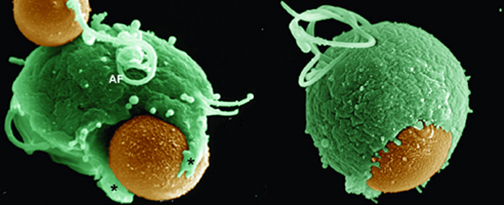
Internal non-specific defenses
Phagocytes
cells which engulf and digest micro-organisms.

Slide 19
Internal non-specific defenses cont.
2 main types of phagocytes involved in non-specific defense
Leucocytes
Have the ability to leave the blood capillaries and migrate through tissues to the place of infection. Can secrete substances to kill bacteria before they engulf them.
Macrophages
Develop from some leucocytes. Can be either fixed in one place waiting for bacteria to come to them or some can wander.

Slide 20
Internal non-specific defenses cont.
Phagocytosis video
http://highered.mheducation.com/sites/0072495855/student_view0/chapter2/animation__phagocytosis.html

Slide 21
Internal non-specific defenses cont.
Inflammation
A typical inflammatory response will show the signs of redness, swelling and heat and pain.
These occur as a result of the process which occurs in response to an infection.
In your text book , read and summarise in dot points/flowchart the seven steps involved in the inflammatory response. Highlight/underline key terms such as mast cells, histamine, heparin etc.
http://www.sumanasinc.com/webcontent/animations/content/inflammatory.html

Slide 22
Internal non-specific defenses cont.
Fever
An elevation of body temperature caused by an increase in the body’s thermostat (controlled by the hypothalamus)
Increased body temperature will:
Inhibit growth of some bacteria and viruses.
Speed up the rate of chemical reactions, allowing cells to repair themselves at a faster rate.
Pyrogens – chemicals released by white blood cells during inflammatory response which act directly on hypothalamus, causing it to lower body temperature.

Slide 23
Lymphatic System
Lymph fluid will carry pathogens to lymph nodes
The lymph nodes form a mesh which traps in bacteria and foreign micro-organisms.
This allow macrophages to come into lymph node and engulf and destroy the pathogen

Slide 24
Helping the body’s non-specific defense
Good Hygiene
Wash hands
Cover mouth
Wear gloves
Wipe surfaces
Use tongs, tweezers, pliers
No sharing!
Mechanical Barriers
Obstacles for invading pathogens eg. face masks protective clothing, gloves, safety glasses, condoms.

